Slide 1
Subject | Life skills
Grade | 3 YEAR 2
Term | 3

Slide 2
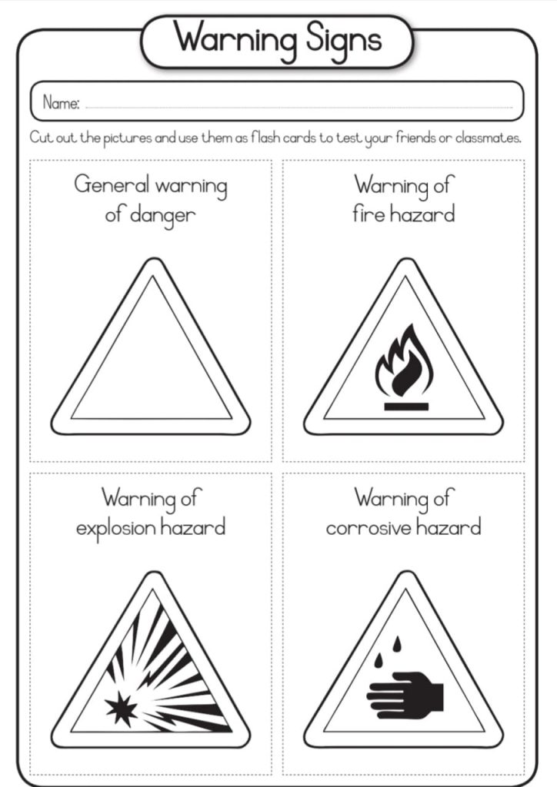
PUBLIC SAFETY
GROUP 1

Slide 3
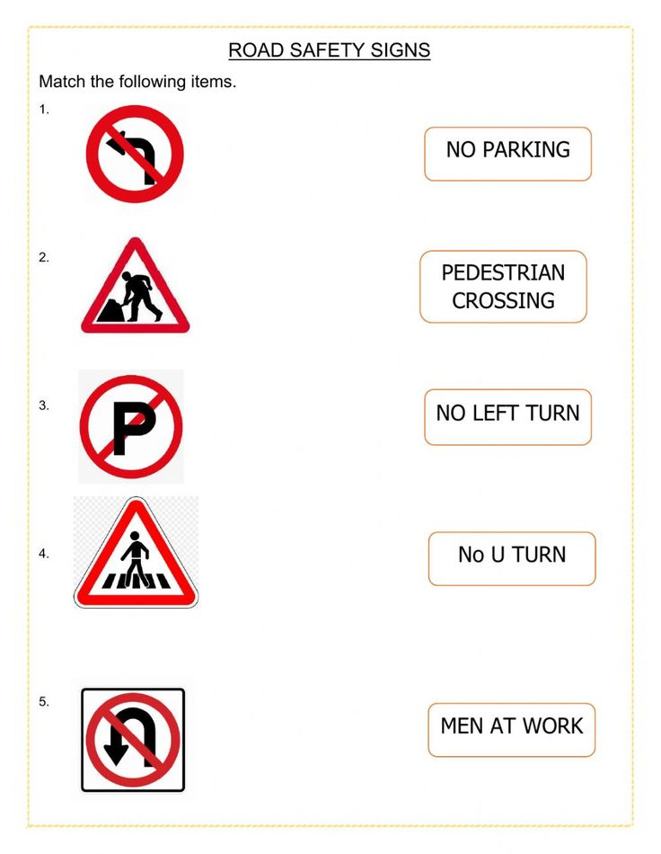
PUBLIC SAFETY
Group 2

Slide 4
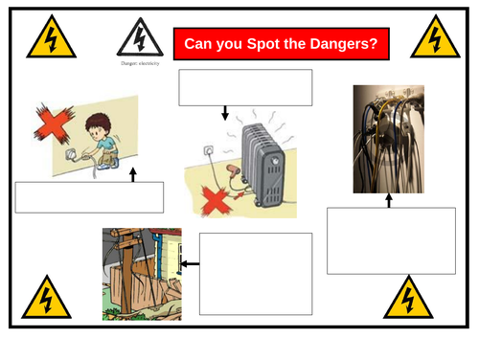
PUBLIC SAFETY
Group 3
Learners are required to spot the dangers of electricity in this worksheet below

Slide 5
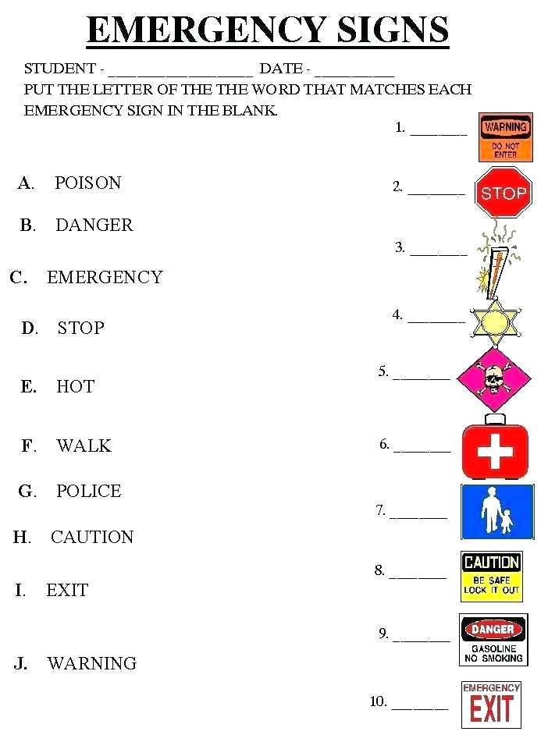
Public safety
Group 3

Slide 6
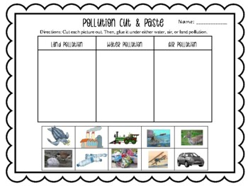
POLLUTION
GROUP 1

Slide 7
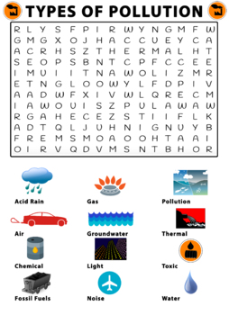
POLLUTION
GROUP 2

Slide 8
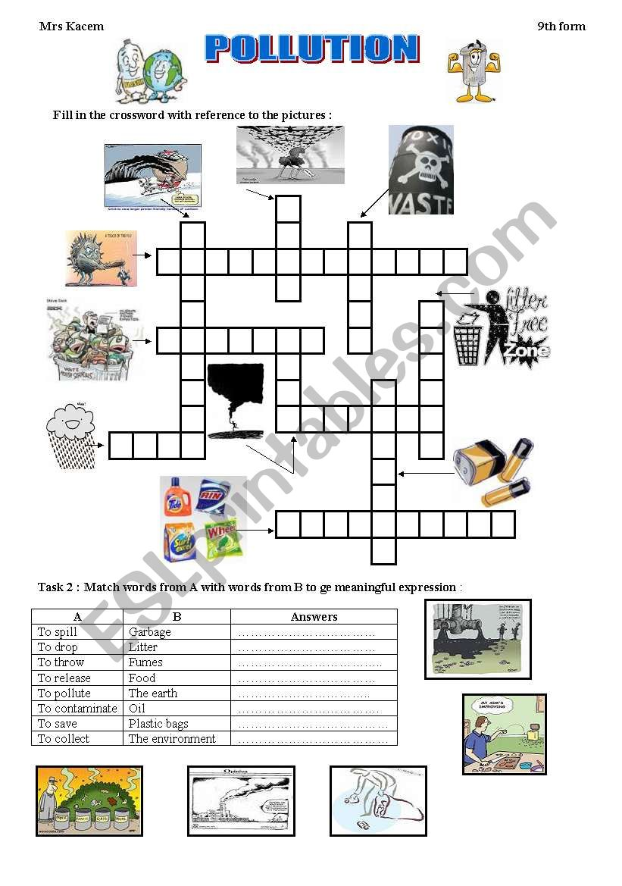
POLLUTION
Group 3
Learners are required to fill in the crossword with reference to the picture

Slide 9
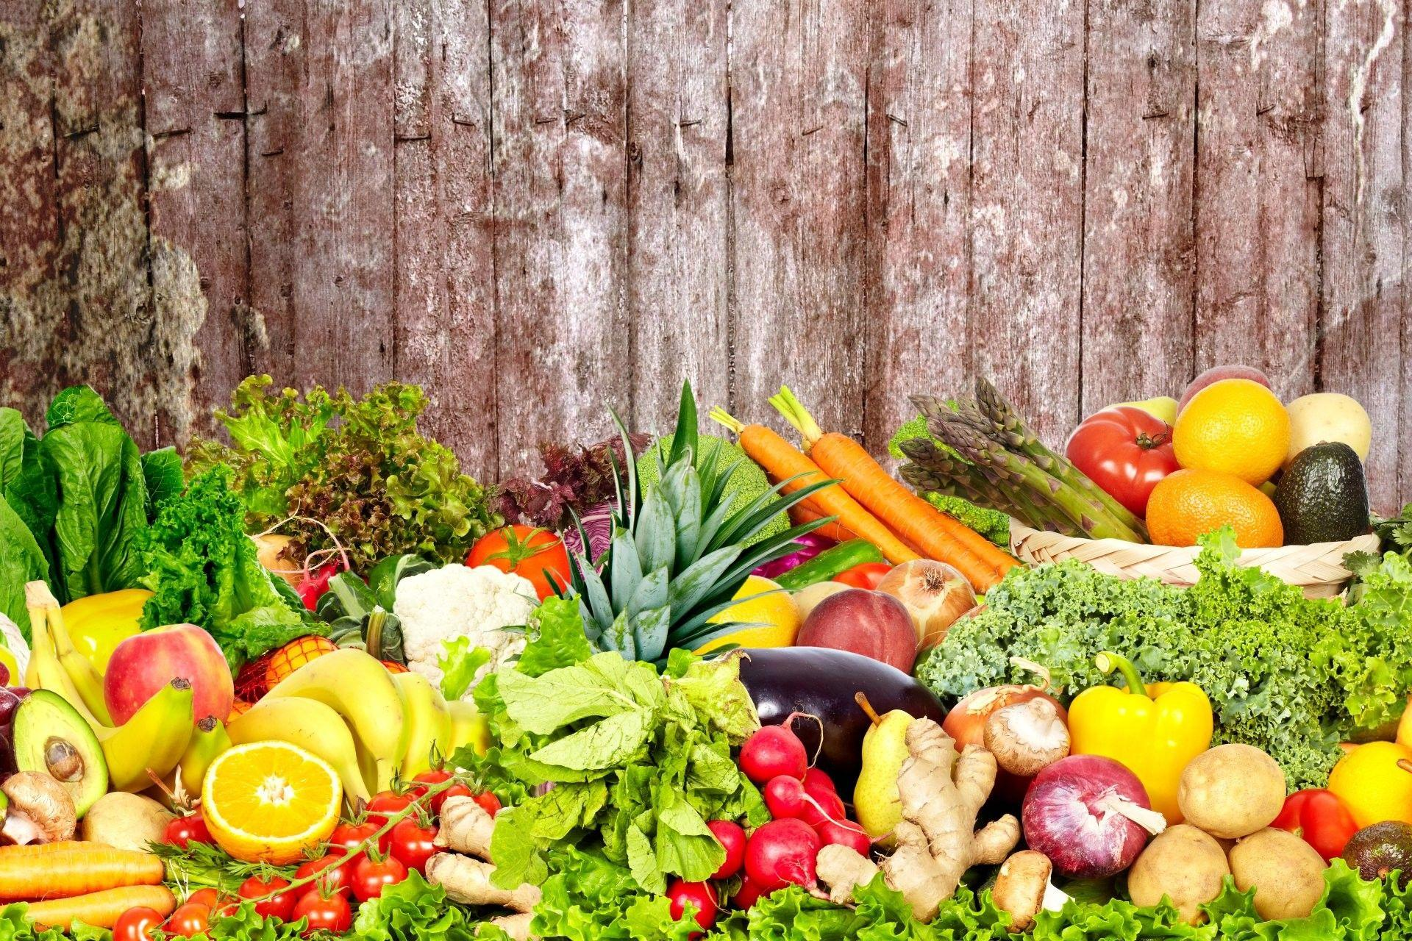
Fruits and vegetables

Slide 10
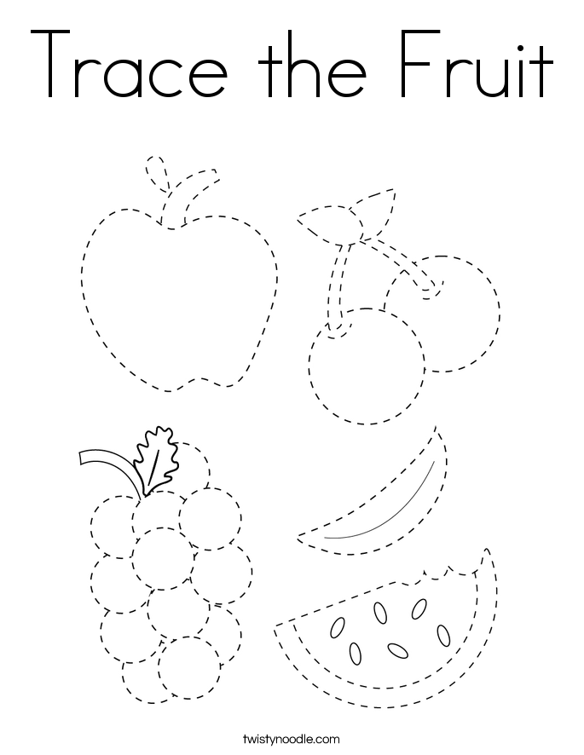
Fruits and vegetables
Group 1

Slide 11
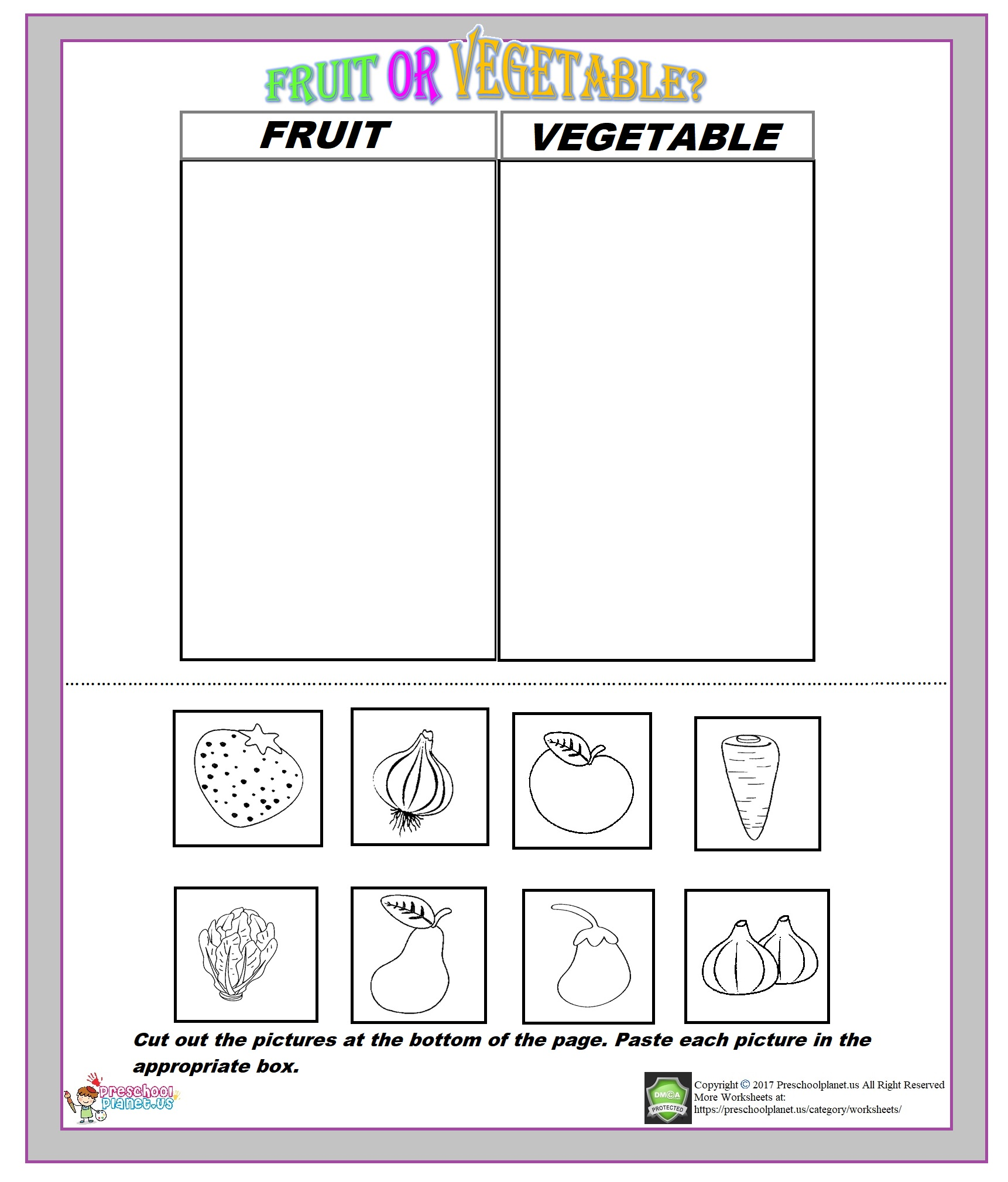
Fruits and vegetables

Slide 12
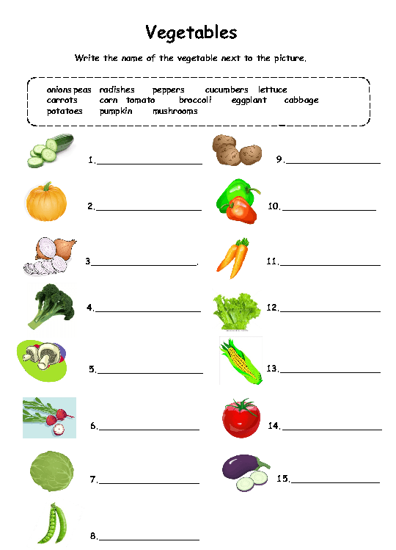
Fruits and vegetables
Group 2

Slide 13
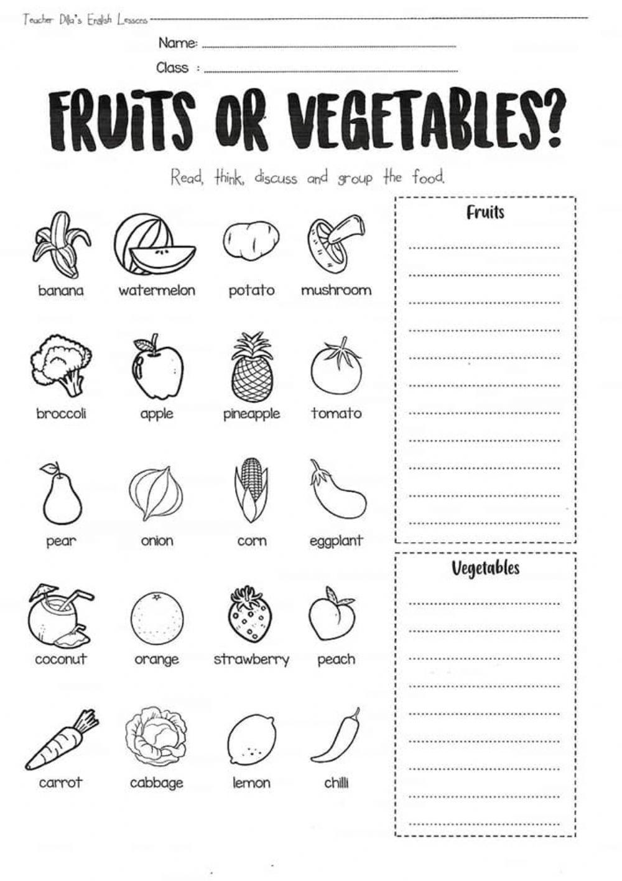
Fruits and vegetables
Group 3

Slide 14
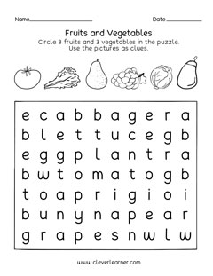
Fruits and vegetables
Group 3

Slide 15
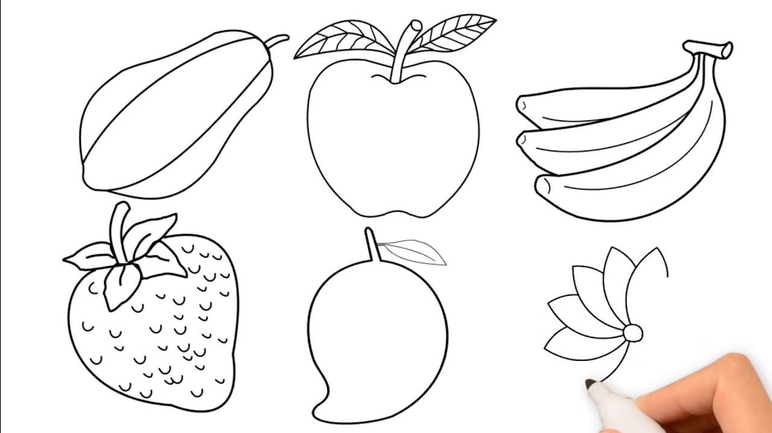
FRUITS AND VEGETABLES
GROUP 3
Learners are required to draw all the fruits below

